Slide 1



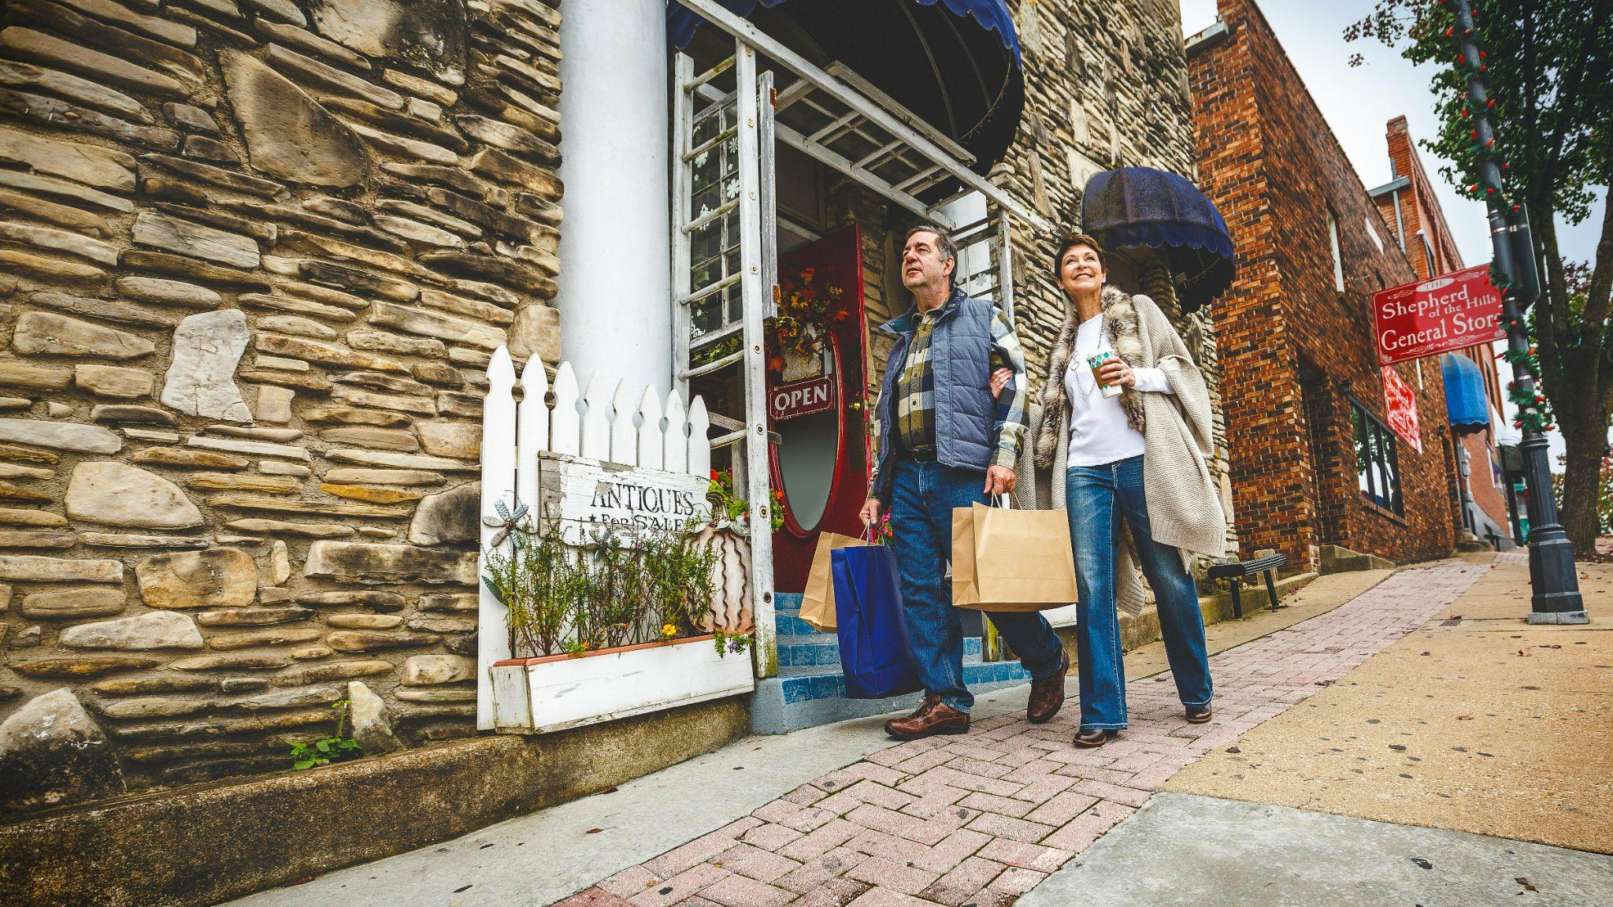


2023 Explore Branson
Community Marketing Presentation
PROGRAMS
Notes:
We’ll be intro’d by Cassandra

Slide 2
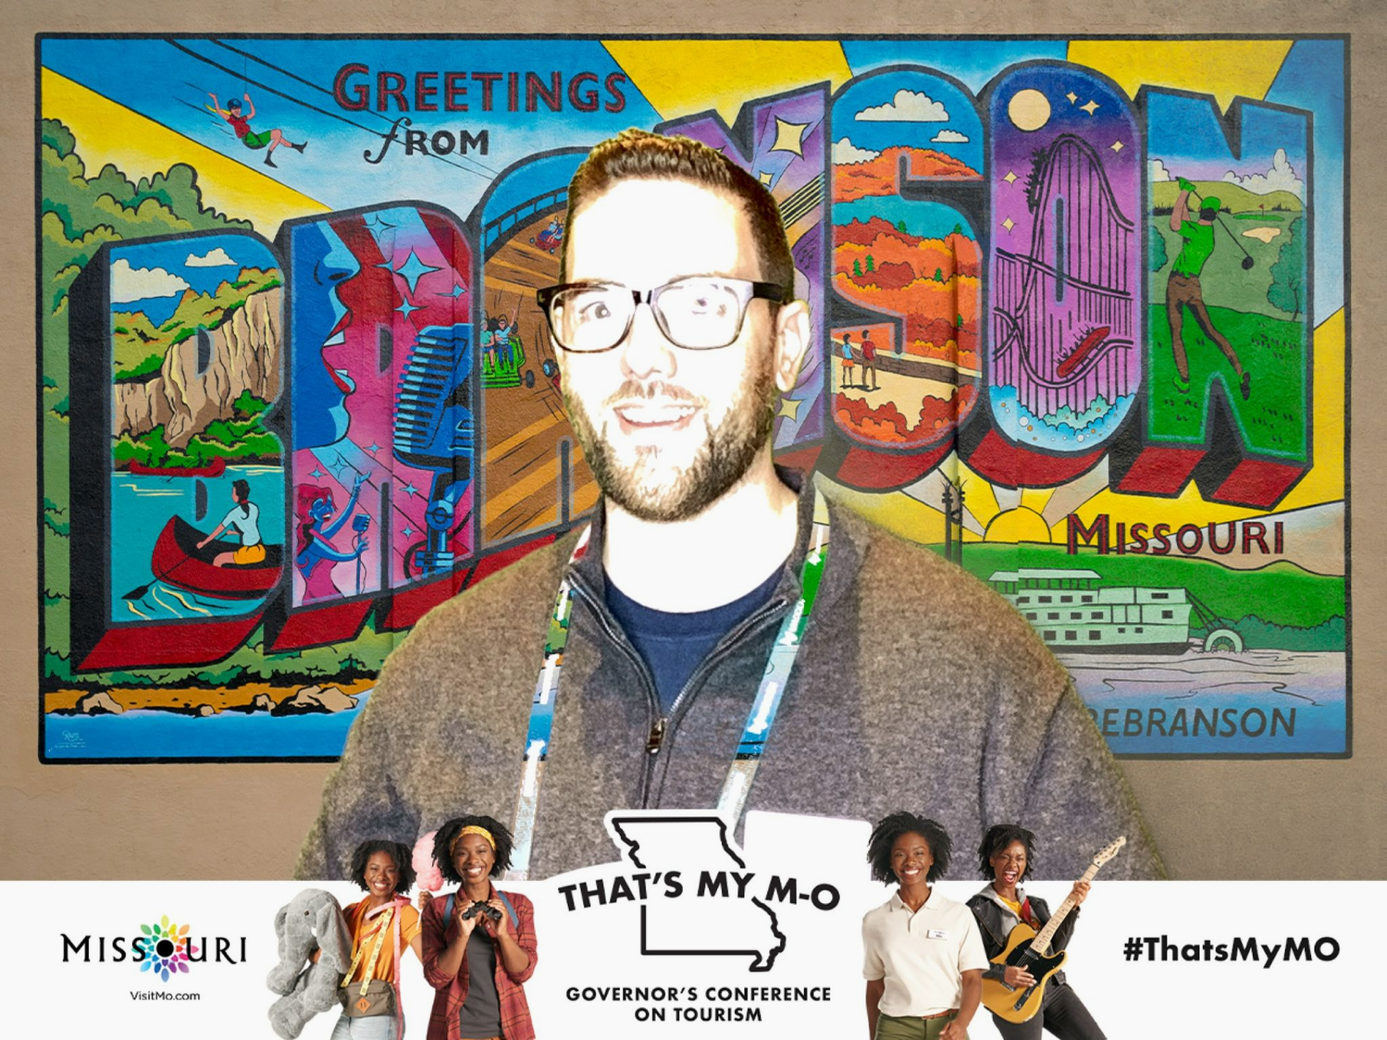

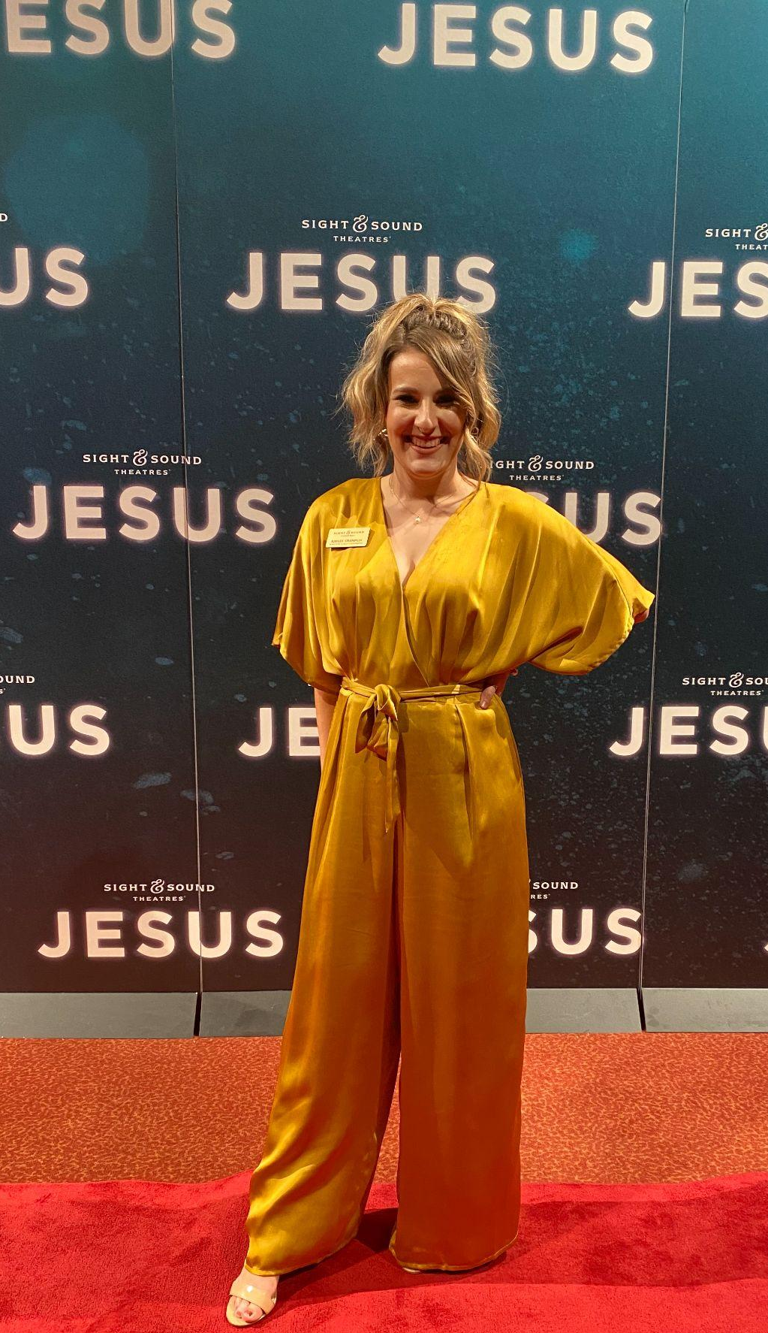
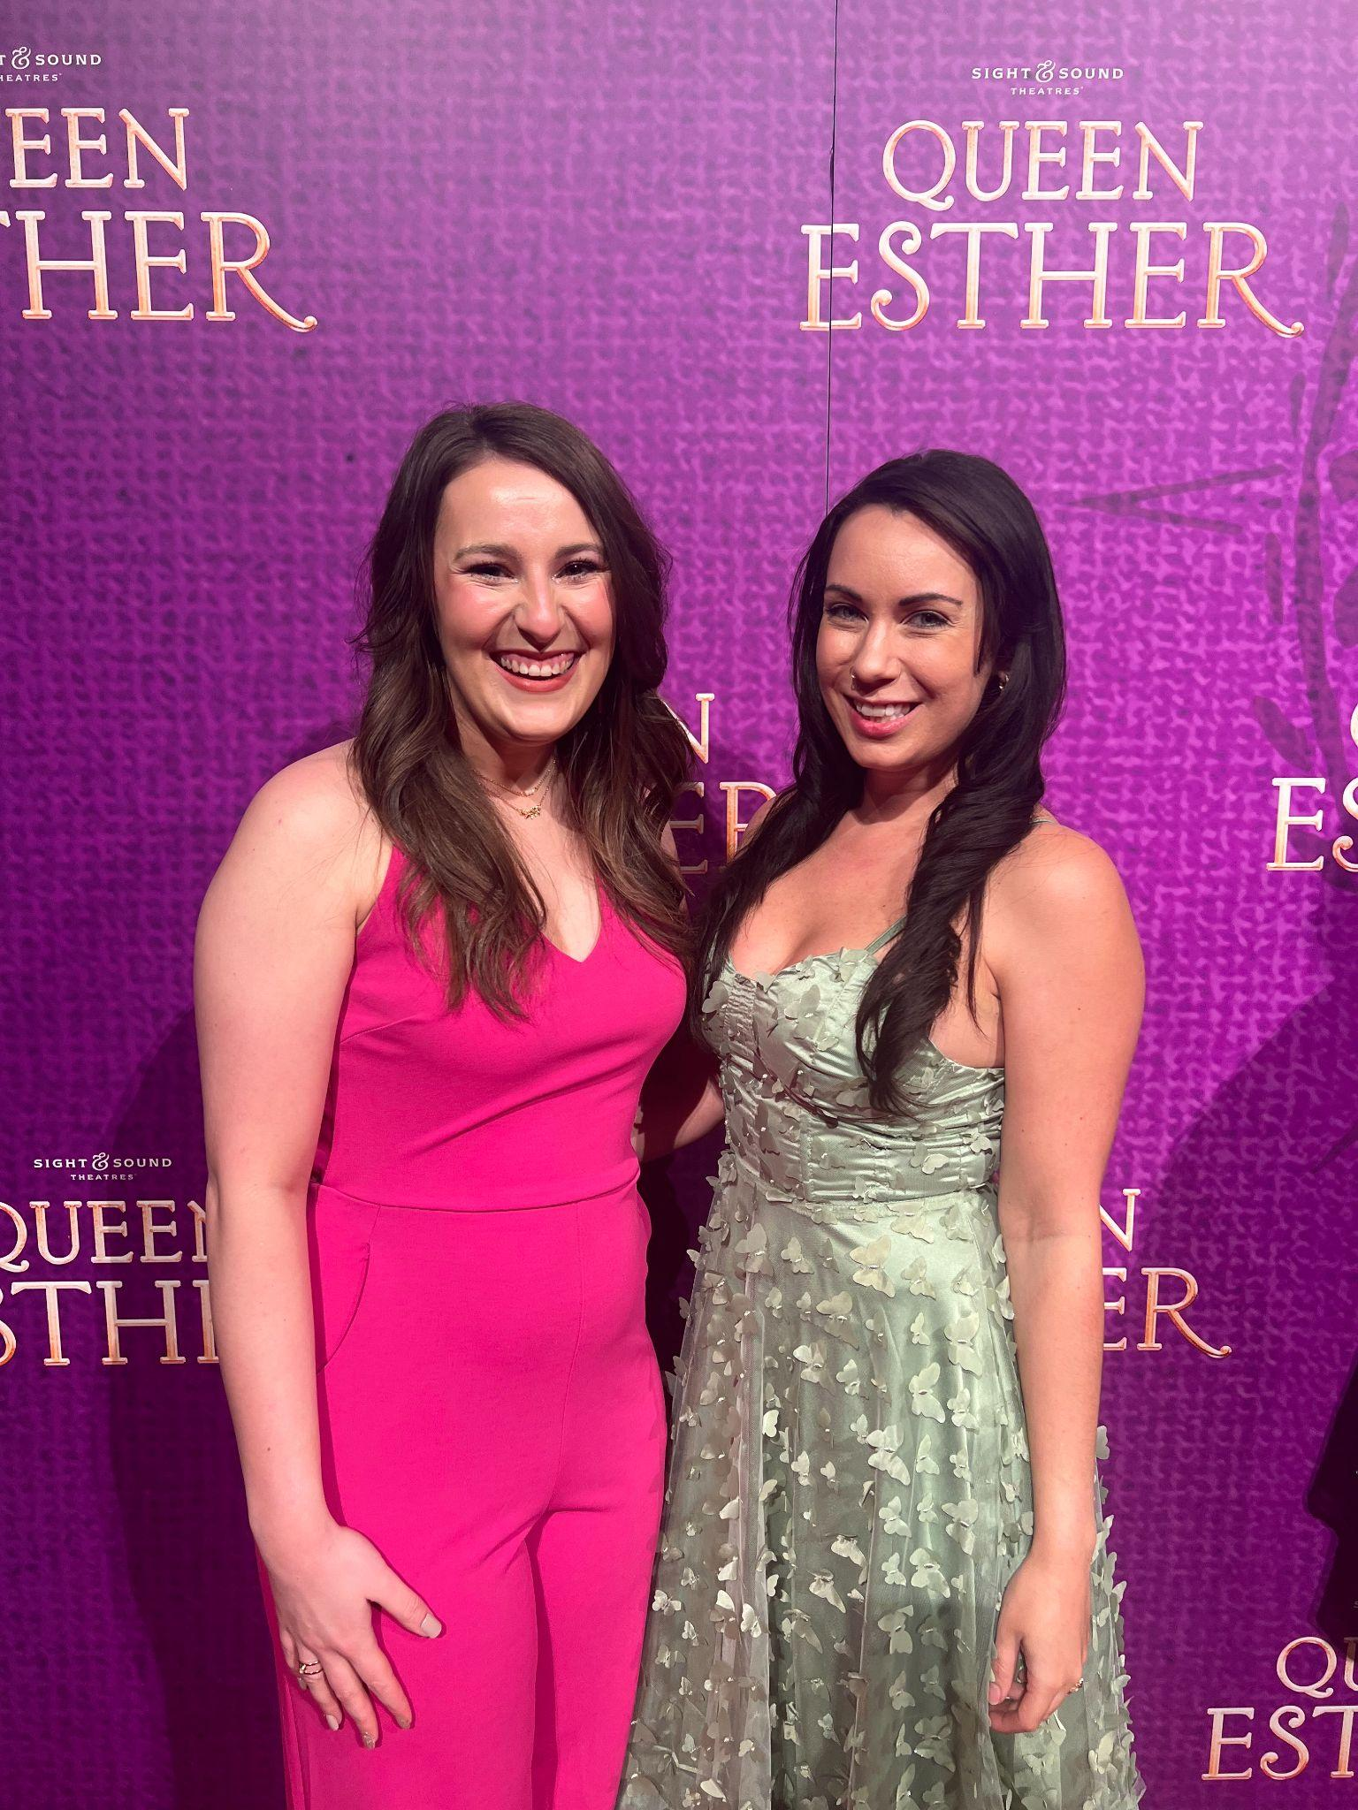
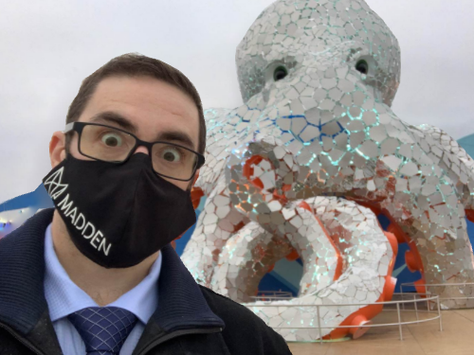
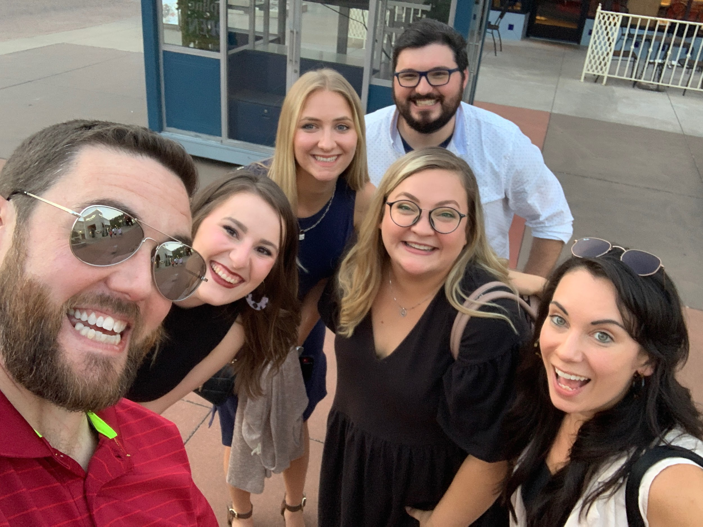
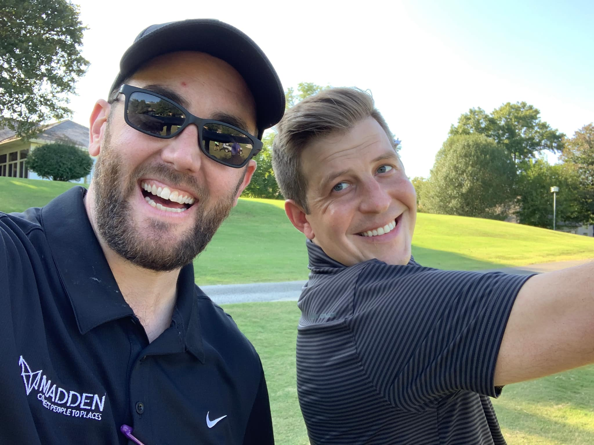

Madden
knows
Branson
Madden has over 110 employees living across the county to serve our partners, but we are local!
Notes:
ronda

Slide 3























Madden is Tourism
We match visitors to destinations from coast to coast through our focus on destination marketing. We partner with over 200 travel and tourism organizations nationally each year.
Every visitor and every destination is unique, and so is each approach!
Notes:
Ronda
In the recipe for marketing success, knowing the destination, its challenges, the politics, and the industry are key ingredients. Having worked in the industry for many years to deliver digital and print cooperative campaigns that increase awareness and stretch partner budgets, we can confidently say that we know co-ops.
Travel & Tourism Experience
Madden has decades of tourism marketing experience and has evolved from a print publisher into a full-service agency exclusively serving DMOs. One of our specialties is building cooperative opportunities that benefit both our clients and their partners. We use the latest technologies, trends, and tactics to deliver successful campaigns and we’d have it no other way.

Slide 4
Branson’s Official Annual
Vacation Guide
Get your message out to potential visitors by advertising in this valuable resource!
Notes:
Ronda

Slide 5

Be Featured in the 2024 Guide
Available in Print and Online!
The Branson Official Visitors Guide provides potential travelers and in-market visitors with an all-encompassing guide to where to stay, where to go, and what to do! Now's the time to join the best of Branson in this go-to resource for those seeking vacation inspiration. 200,000+ printed copies circulated
Materials and payment due: November 11th, 2023
Published January 2024
Print Circulation 200,000+ annually
Distributed: January-February 2024
Ad Close Date: November 11th, 2023
Submit materials to vacationguide@bransoncvb.com via DropBox or by email

Slide 6
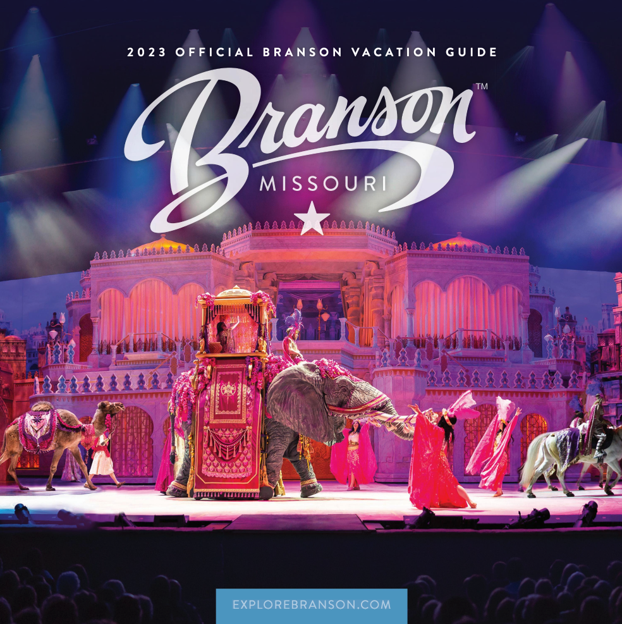
Be Featured in the 2024 Guide
Available in Print and Online!
The Branson Official Visitors Guide provides potential travelers and in-market visitors with an all-encompassing guide to where to stay, where to go, and what to do! Now's the time to join the best of Branson in this go-to resource for those seeking vacation inspiration. 200,000+ printed copies circulated
Materials and payment due: November 11th, 2023
Published January 2024
Print Circulation 200,000+ annually
Distributed: January-February 2024
Ad Close Date: November 11th, 2023
Submit materials to vacationguide@bransoncvb.com via DropBox or by email

Slide 7

Be Featured in the 2024 Guide
Available in Print and Online!
The Branson Official Visitors Guide provides potential travelers and in-market visitors with an all-encompassing guide to where to stay, where to go, and what to do! Now's the time to join the best of Branson in this go-to resource for those seeking vacation inspiration. 200,000+ printed copies circulated
Materials and payment due: November 11th, 2023
Published January 2024
Print Circulation 200,000+ annually
Distributed: January-February 2024
Ad Close Date: November 11th, 2023
Submit materials to vacationguide@bransoncvb.com via DropBox or by email

Slide 8
Digital Marketing
Partnerships
Notes:
Ronda

Slide 9
ExploreBranson.com Analytical Overview
Site Visits
eNewsletter
Average Time on Site
3.8 Million
71,000+ e-Newsletter deliveries
2 Min, 26 Sec
Top Views in page views
72% Traffic from Mobile/Tablet
Top 10 Attractions Article - 609,106
/Home - 527,843
/Things To Do - 310,314
/Shows - 299,409
/Attractions - 226,127
/Vacation Guide - 153,022
/Fall - 138,318
/Whats-New-Branson - 132,032
/New Things to Do Article - 132,032
/Cabins - 111,586
/Eat - 103,725
Outdoors wasn’t
Top 10 in 2019
Notes:
jeff

Slide 10


THE BEST PART
72% of all Website Traffic
were new users!
( Three Years in a Row! )
Notes:
It’s pretty much as fun as it sounds

Slide 11
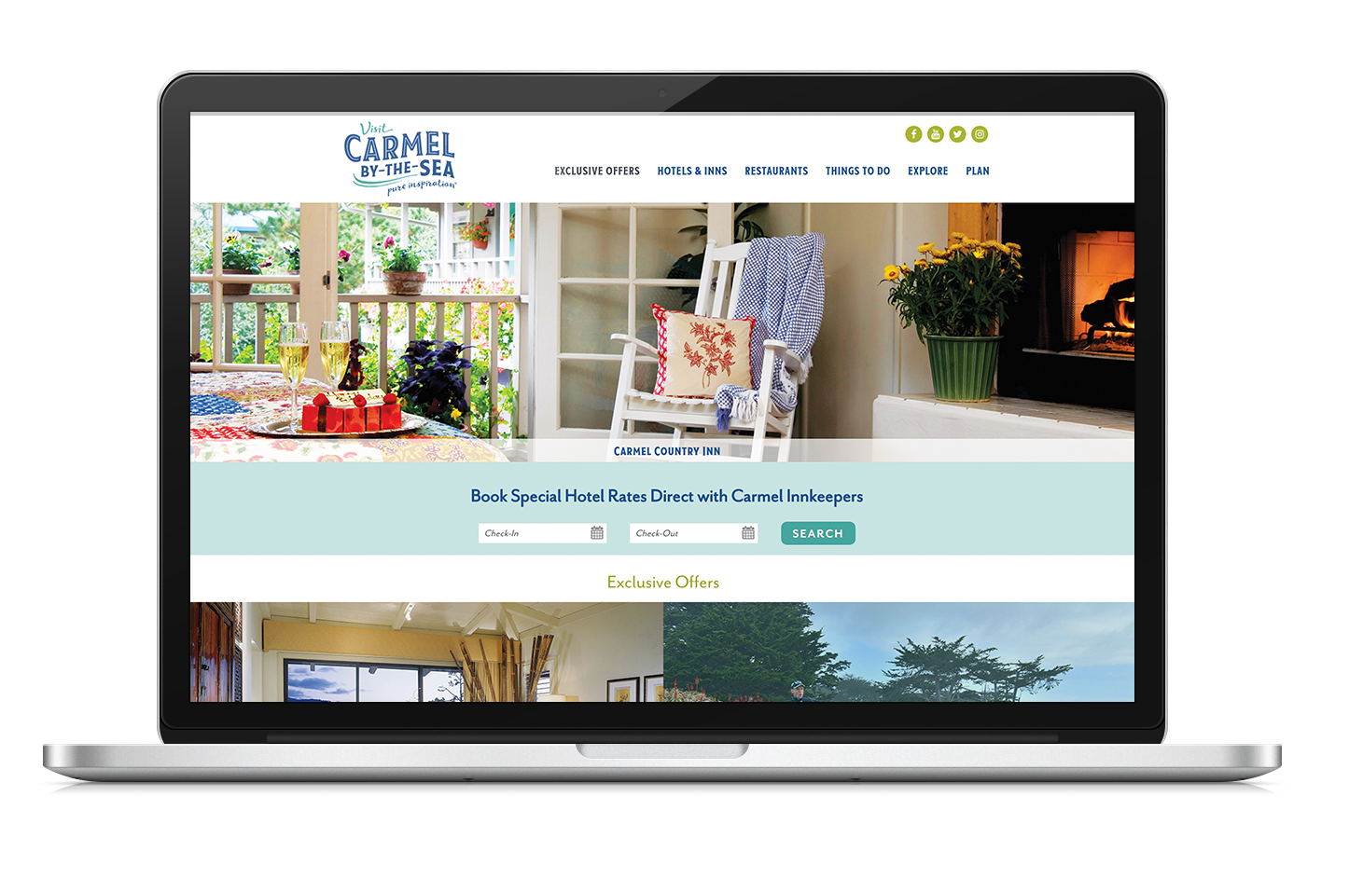
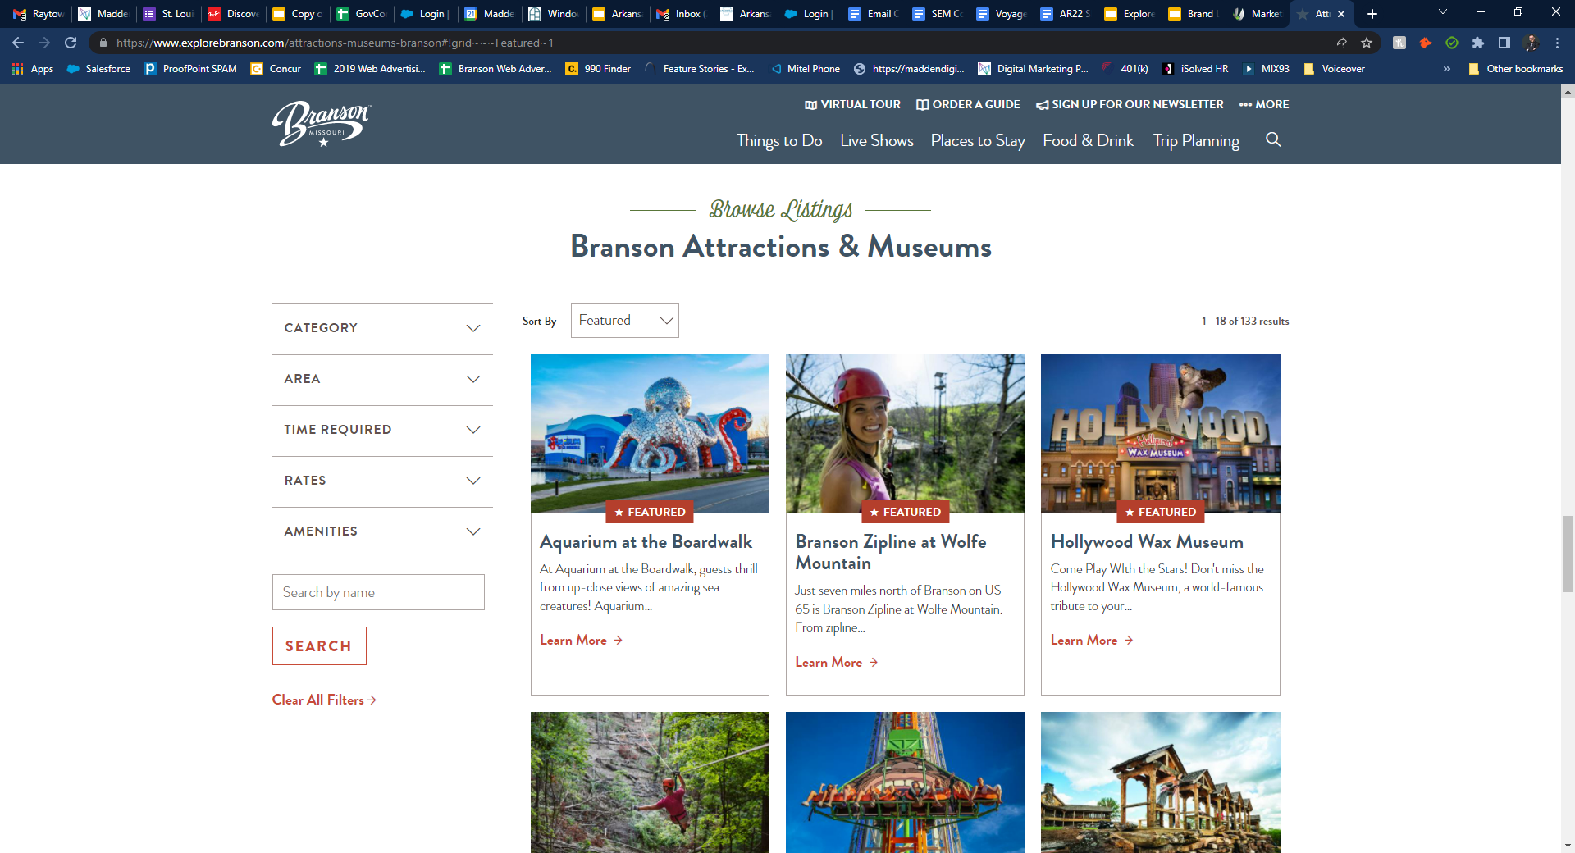
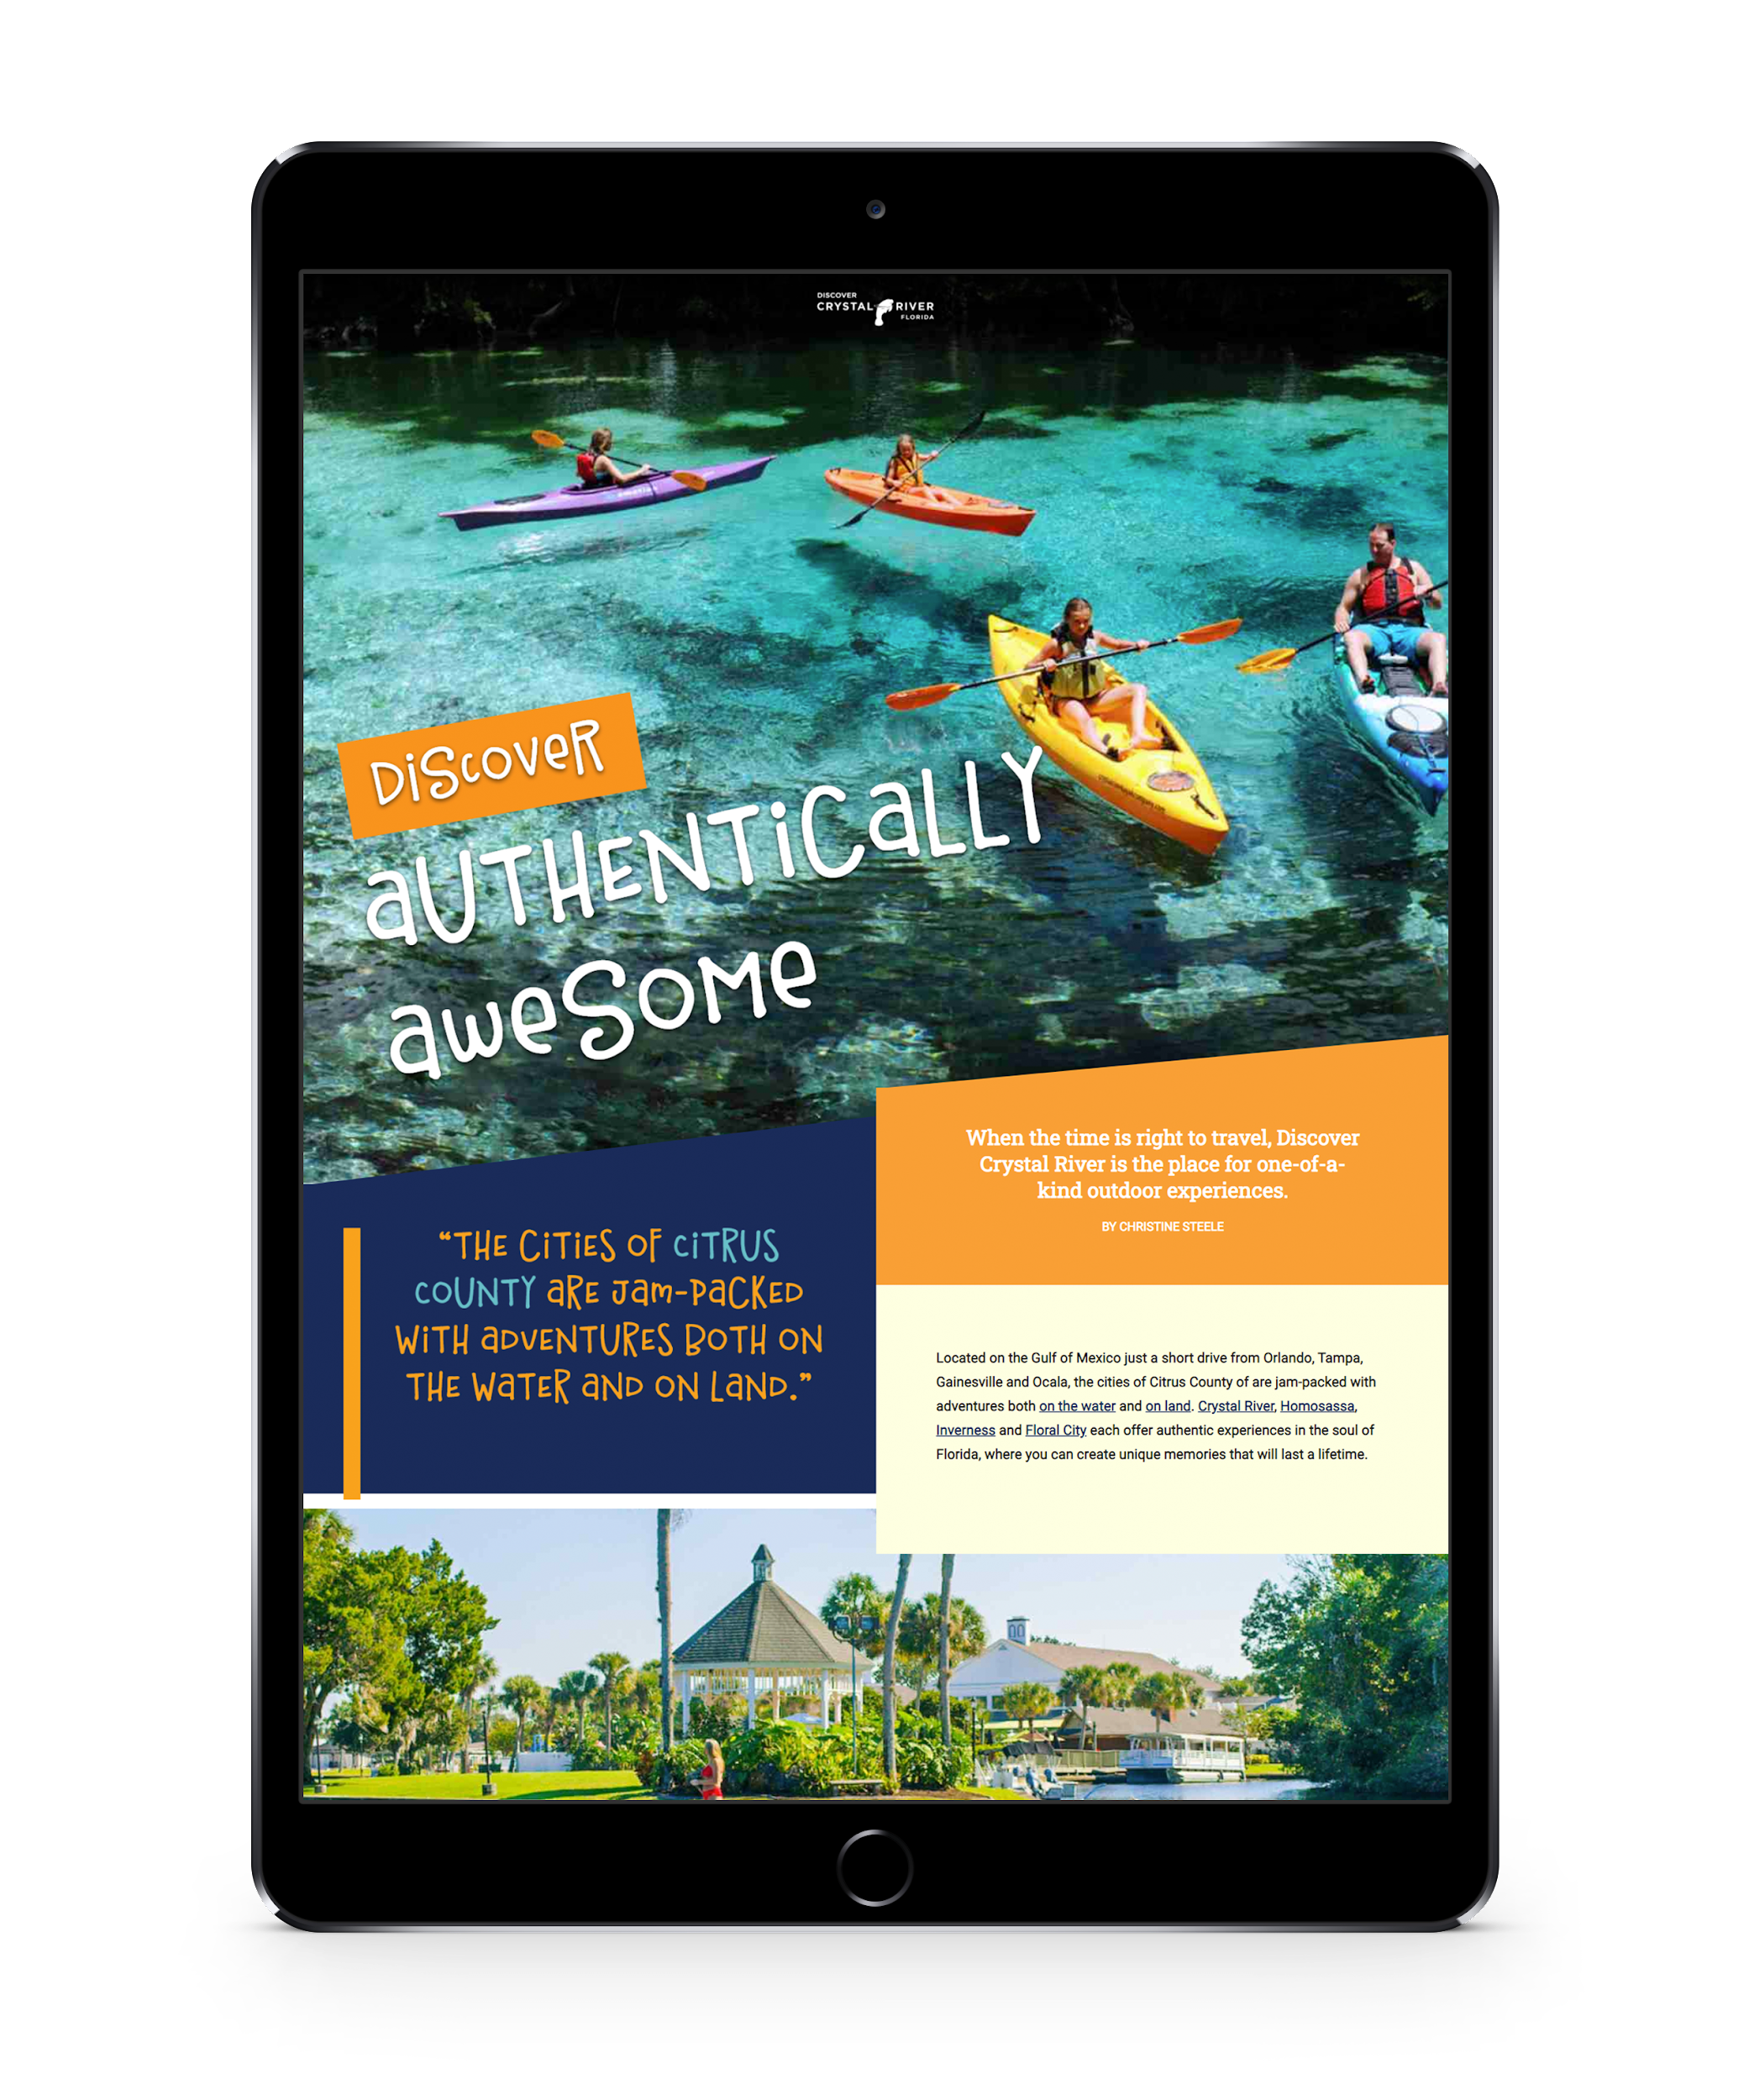
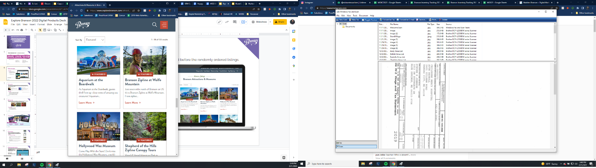
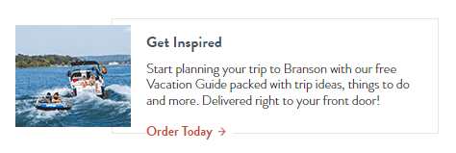
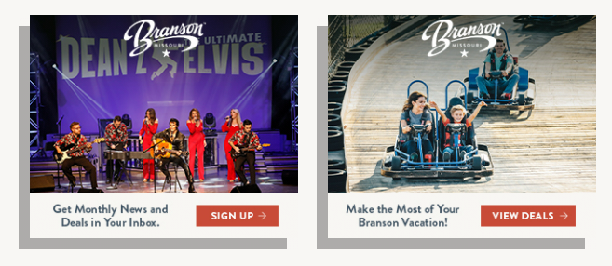
Featured Listing
Place your business at the top of the business listing section and before the randomly ordered listings.
Native Ads
Feature your business in formatted, advertorial text and pictures in the same font/style as Explore Branson’s editorial content. There is very limited availability for native ads.
Banner Ads
Partner-supplied banners appear on ExploreBranson’s editorial pages and influence users as they seek information during travel planning.
Notes:
jeff

Slide 12
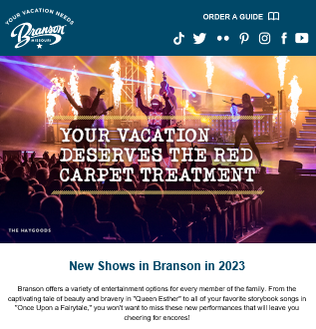
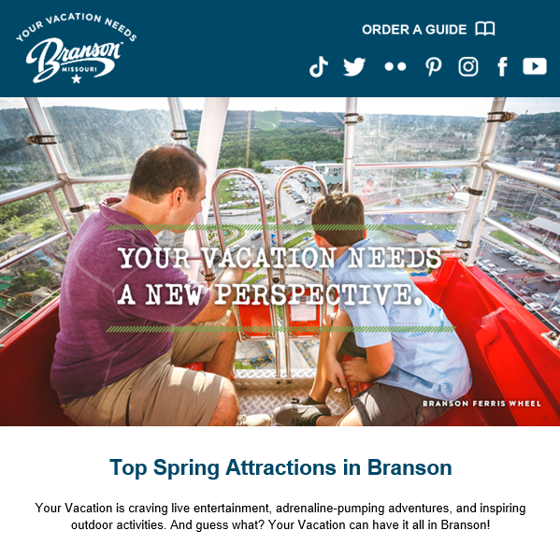
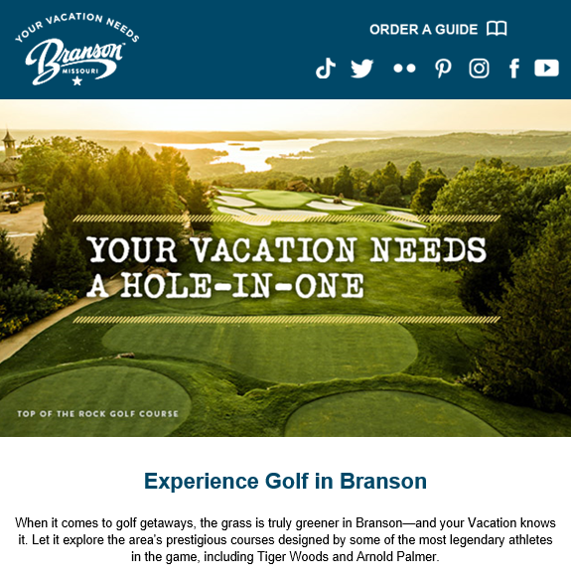
eNewsletter
Performance Stats
71,000+
51.52%
10.68%
Subscribers
Avg Open Rate
Click-Through Rate
Notes:
jeff

Slide 13
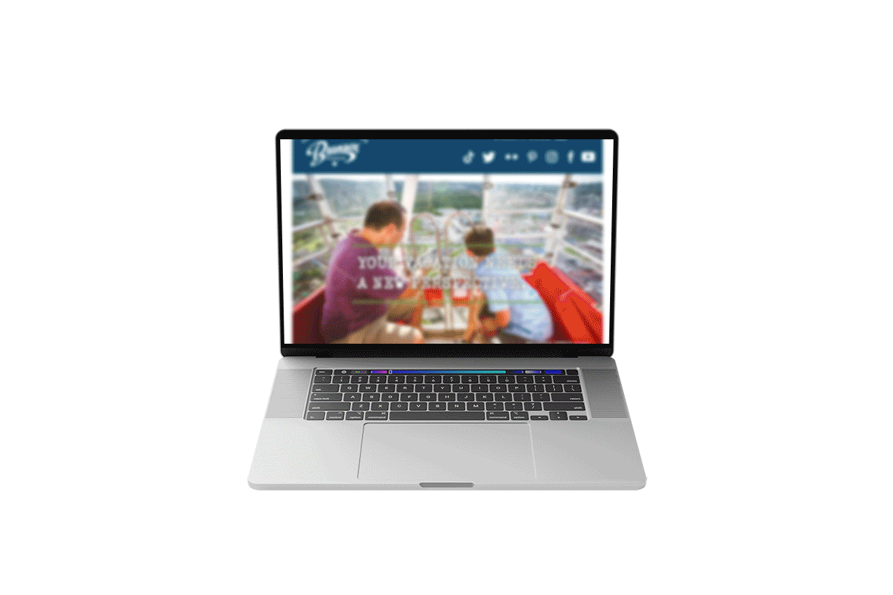
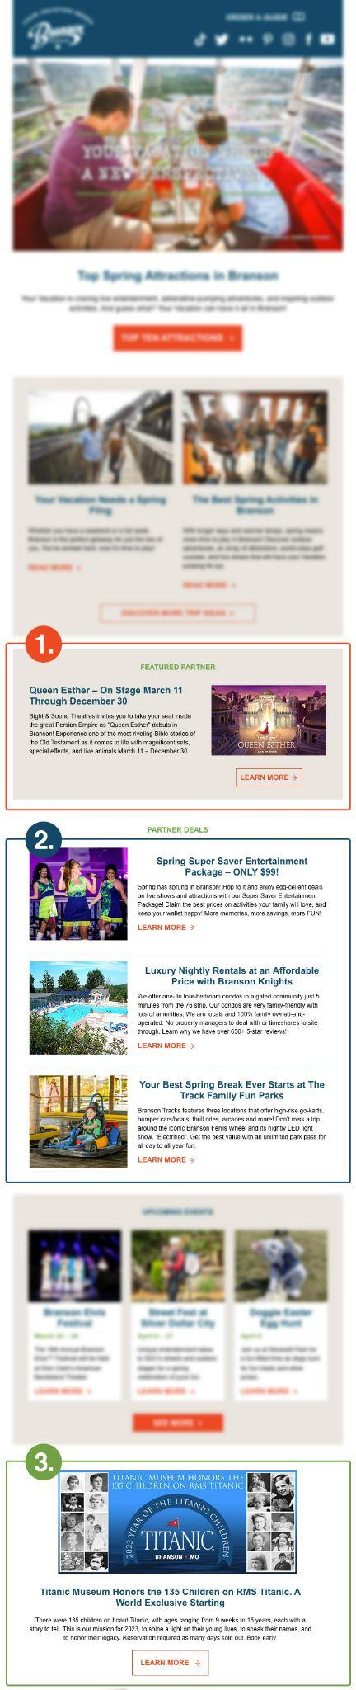
eNewsletter
Reach a highly qualified list of Branson visitors with the Explore Branson newsletter. Sent monthly, the newsletter is a great channel to announce upcoming events and/or timely deals and to push visitors to your website.
And….Growing!
71,000+ Subscribers
Featured Sponsor (1 available per month): Premium position; receive maximum exposure with a large call-out that links directly to your website.
Deals & Packages (3 available per month): Drive conversions by advertising a special deal or package and setting your business apart from the competition.
Promotional Ad (1 available per month): Utilize this double column photo opportunity that will catch the eye of the reader.
Notes:
jeff

Slide 14
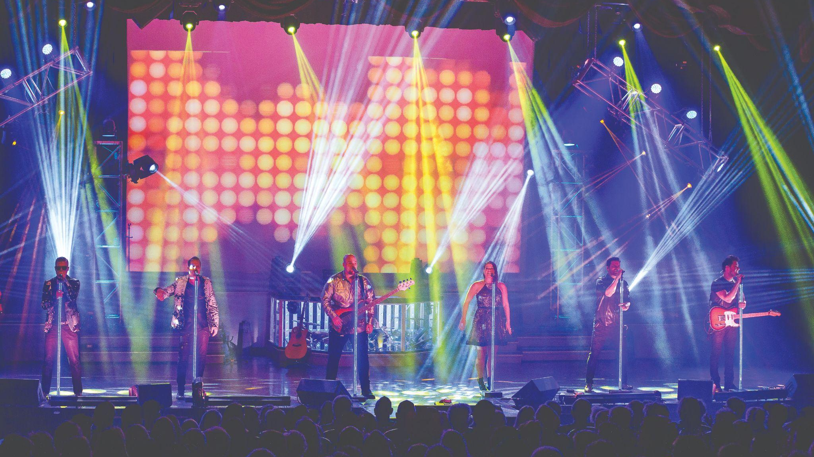

Digital Marketing Co-Op Programs
LIVE SHOWS
Search Engine Marketing
Notes:
Jeff throws back to Ronda

Slide 15

LIVE shows in Branson!
Digital Marketing Partnership:
This co-op eliminates keyword competition between participants and maximizes value for all partners’ marketing efforts. The program ensures partners receive a greater share of relevant and interested consumers going to their site rather than a competitor’s while not bidding against the CVB.
Explore Branson provides 100% match funding model with a $600,000 maximum match limit within 12 months
Benefit from a non-competitive keyword environment
Run Dates: January 1, 2023 through 2023 calendar year
Madden Media will work with each partner to consult and create a keyword target list based on the individual goals of partners, in combination with Branson CVB KPIs.
Notes:
Ronda-recaps and confirms next year’s program

Slide 16











What Happened Last Year:
SEM overall partner performance through 12/31/2022
8.44% Overall Campaign CTR
9.88 Million Total Impressions
541K Total Clicks
Notes:
w/o God & Country yet

Slide 17








Ask How to Get Involved!
2023 SEM Partners to date:
Notes:
w/o God & Country yet

Slide 18
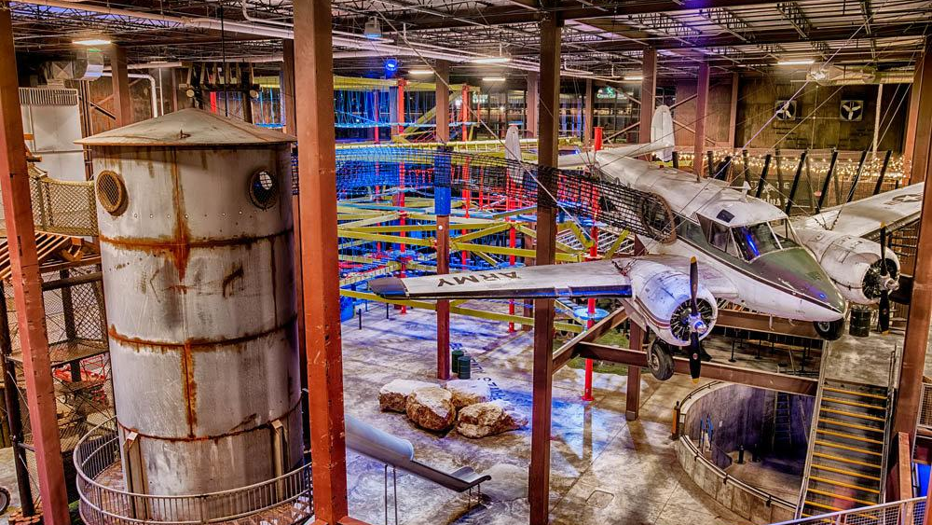
COMING SOON
Digital Marketing Co-Op Program
ATTRACTIONS
Search Engine Marketing
Notes:
Jeff throws back to Ronda

Slide 19
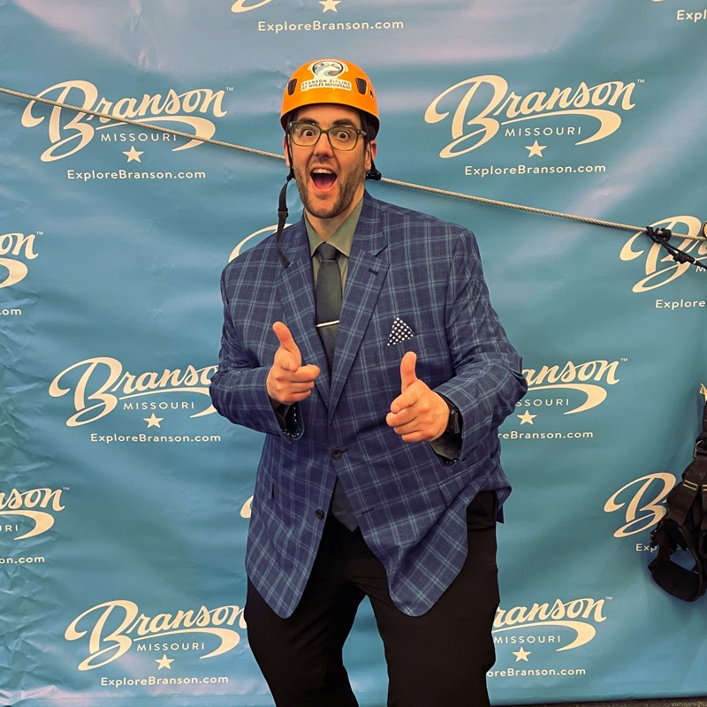
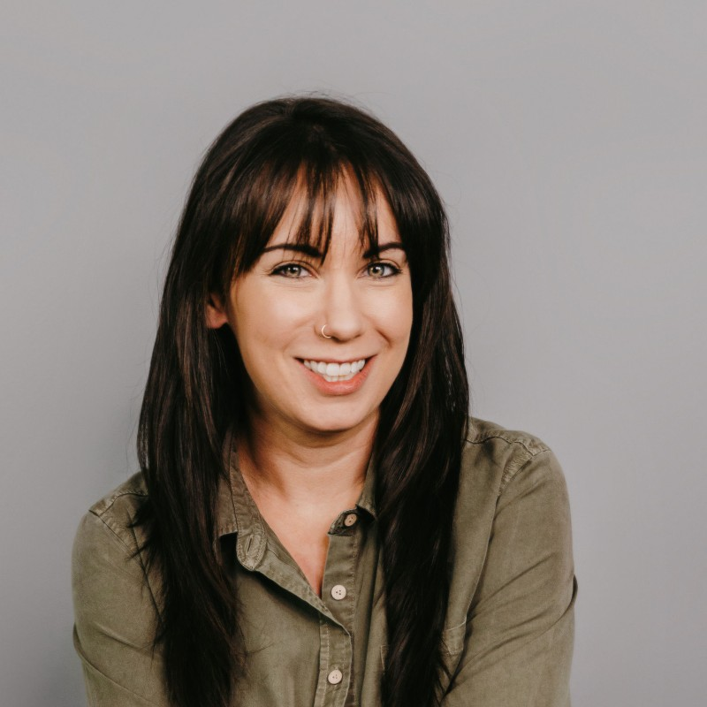
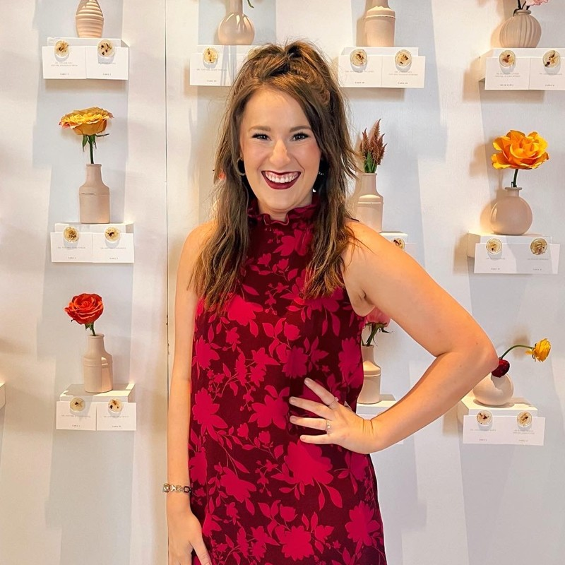
YOUR DEDICATED TEAM
Jeff Hirst, Destination Development Specialist
Branson Vacation Guide
ExploreBranson.com Advertising
jhirst@maddenmedia.com | 816-806-4437
Taylor Goessmann, Destination Strategy Director
Digital Marketing Co-Op Program
Live Shows & Attractions Search Engine Marketing
tgoessmann@maddenmedia.com | 573-645-1920
Kaylee Champlin, Account Specialist
Digital Marketing Co-Op Program
Search Engine Marketing
Active Campaign Management
Notes:
Ronda

Slide 20
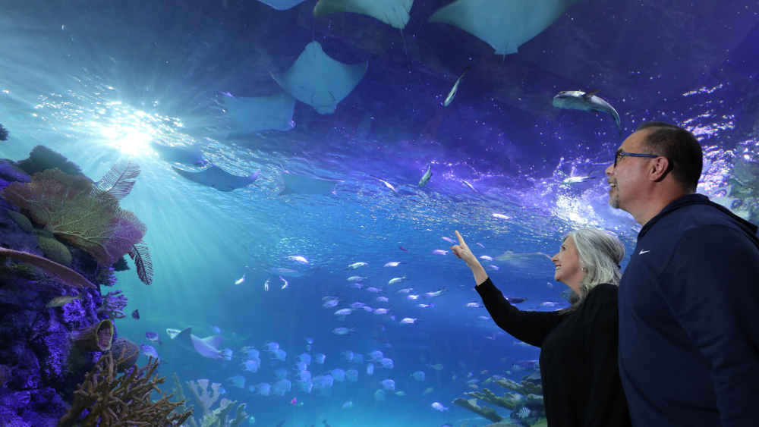
Thank YOU!

